Slide 1


HIGH CLOUD AIRLINES Approach to Enhancing Customer Satisfaction and Operational Efficiency.
-Presented by Group-1 ( Pallavi, Isha, Sonal, Minnow)
Mentored by: Mr. Himavanth | Co-Mentored by: Mr. Pavan Kumar

Slide 2
CONTENTS
Project overview
Dashboard & Analysis work
KPIs
Dashboards
Challenges Faced
Conclusion
Suggestion

Slide 3




GROUP-1
Sonal Kahar
(Data Analyst)
Minnow Bhandari
(Business Analyst)
Isha Srabani
(Business Analyst)
Pallavi Kulkarni
(Business Analyst)

Slide 4
Project Overview: High Cloud Airlines
This project aimed to analyze the operations and financial performance of High Cloud Airlines using actual airline data. With data from over 100 across various carriers.
Analyze passenger travel behavior over time to identify trends, such as peak travel seasons or preferred days of the week.
Assess how efficiently available seats are being filled on different routes and flights through load factor analysis.
Find out which carriers are performing best in terms of passenger load and route success.
Understand passenger trends and route performance, Evaluate load factor and seat utilization, Identify top-performing carriers, data-driven decision-making.

Slide 5
Dashboard & Analysis Work
We used all four tools—Excel, SQL, Tableau, and Power BI—to perform in-depth analysis and create meaningful dashboards.
Each tool helped answer specific business questions related to
Passenger trends
Load factor calculations
Route and carrier performance
Weekend vs Weekday comparison
Dashboards made it easier to visualize the data and draw insights for better airline planning and strategy.

Slide 6
KPIs

Slide 7
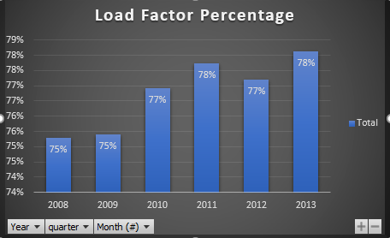
load Factor percentage on a yearly , Quarterly , Monthly basis ( Transported passengers / Available seats)
The load factor percentage increased from 75% in 2008–2009 to 78% by 2013, showing overall growth in seat utilization.
The highest load factor was recorded in 2011 and 2013, both at 78%, indicating peak efficiency in those years.
A steady improvement is seen from 2010 onwards, with a slight dip in 2012 to 77%, then rising again.
This trend reflects that High Cloud Airlines improved its passenger management and operational efficiency over the year

Slide 8
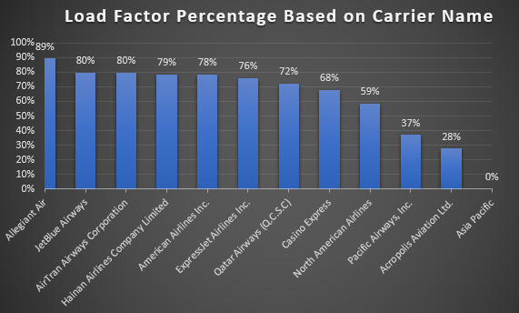
load Factor percentage on a Carrier Name basis ( Transported passengers / Available seats)
This chart shows how different airlines performed in terms of seat utilization, calculated using the formula: (Transported Passengers / Available Seats).
The top contributors to load factor are Allegiant Air (13%), AirTran Airways (12%), and ExpressJet Airlines (11%) — indicating high passenger seat usage.
Airlines like Acropolis Aviation and Hainan Airlines show only 4% and 5% respectively, meaning lower efficiency in filling available seats.
This analysis helps compare which carriers are effectively using their flight capacity and which need operational improvements.

Slide 9
DASHBOARD

Slide 10
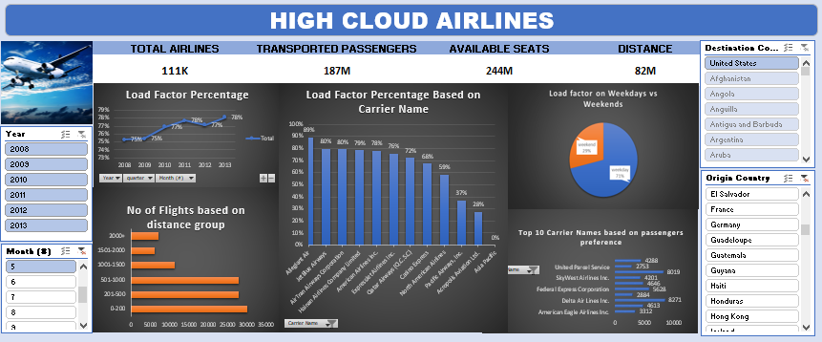
EXCEL

Slide 11
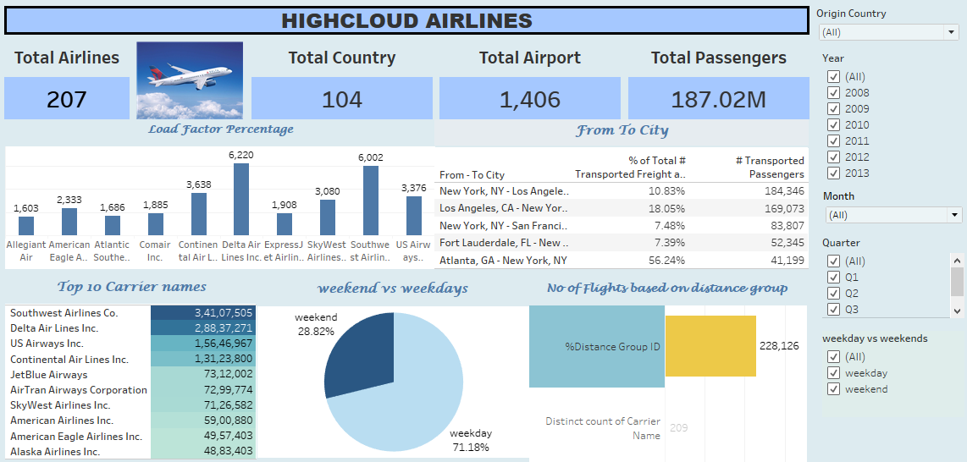
TABLEAU

Slide 12
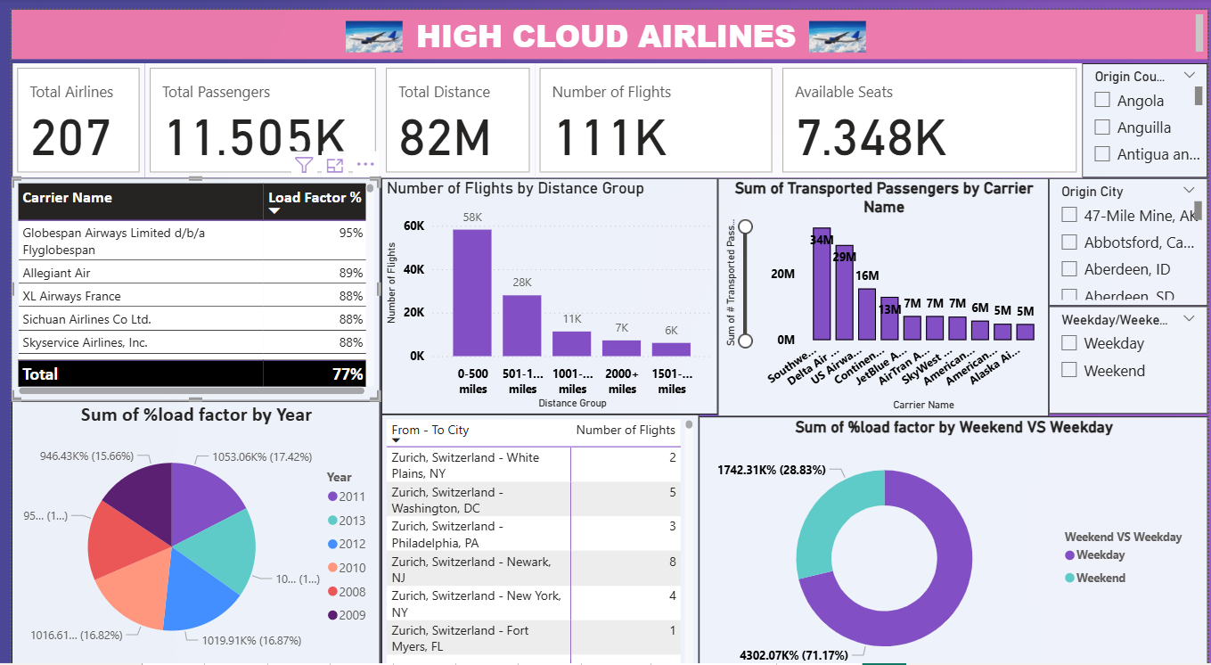
Power BI

Slide 13
Challenges Faced
While working on the High Cloud Airlines project, our team did not face any major challenges, thanks to effective communication, strong teamwork, and mutual support.
Some minor areas where we had to stay attentive included:
Understanding the business questions clearly before approaching the data
Ensuring accuracy and consistency while switching between tools like Excel, SQL, Tableau, and Power BI
Overall, the collaborative environment and everyone’s active contribution helped us complete the project smoothly and efficiently.

Slide 14
CONCLUSION
Our analysis of High Cloud Airlines revealed valuable insights into passenger behavior, route performance, and carrier efficiency. The consistent increase in load factor over the years signifies improved operational efficiency and effective passenger management. Tools like Excel, SQL, Tableau, and Power BI enabled us to visualize trends clearly and support data-driven decision-making. The project highlighted how analytics can empower airlines to optimize operations, enhance customer satisfaction, and drive business growth.

Slide 15
SUGGESTION
Focus on Underperforming Carriers: Airlines like Acropolis Aviation and Hainan Airlines show low seat utilization; targeted strategies like marketing offers or schedule optimization could help boost their load factors.
Leverage Peak Seasons: Since certain years like 2011 and 2013 showed peak efficiency, analyzing what worked during those periods can help replicate success.
Invest in Predictive Analytics: Use advanced forecasting techniques to anticipate passenger demand and plan routes more strategically.
Improve Weekend Planning: If weekend vs weekday comparisons show discrepancies, the airline should adapt flight frequency and pricing based on demand trends.
Tool Integration for Real-Time Decisions: Implement a system where dashboards from tools like Power BI and Tableau are used live for continuous monitoring and quicker responses.

Slide 16
THANK YOU

